Slide 1


Learning Amyloid Pathology Progression from Longitudinal PiB-PET images in Preclinical Alzheimer's disease
International Symposium on Biomedical Imaging, 2020
Wei Ha$o$ [1] Nicholas M. Vogt [1] Zihang Meng[1] Seong Jae Hwang [2] Rebecca L. Koscik [1] Sterling C. Johnson [1,3] Barbara B. Bendlin [1] Vikas Singh [1]
[1] University of Wisconsin-Madison [2] University of Pittsburgh [3]William S. Middleton Memorial Veterans Hospital
Notes:
Hi! I am Wei Hao, an undergrad student from U of Wisconsin- Madison,
Today, I’ll talk about [Title]. This is a joint work with Nicholas Vogt , Zihang Meng, Seong Jae Hwang, Rebecca Koscik, Sterling Johnson, Barbara Bendlin and Vikas Singh.

Slide 2
NEUROIMAGING AND ALZHEIMER’S DISEASE (AD)
Alzheimer’s disease (AD)
Neurodegenerative disease
One of the leading causes of dementia
Neuroimaging data
Measures specific pathologies related to AD
Notes:
First, I want to provide a little bit of background information.
Alzheimer’s disease, is a neurodegenerative disease, one of the leading causes of dementia. One way to understand Alzheimer’s disease is to analyze neuroimaging data to measure specific pathologies related to AD.

Slide 3
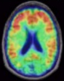
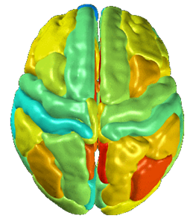
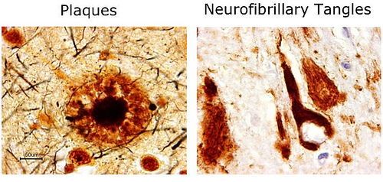
NEUROIMAGING AND ALZHEIMER’S DISEASE (AD)
PiB PET imaging
(Pittsburgh compound B)
(Positron-emission tomography)
$↑\text{PiB} \text{Distribution} \text{V}\text{olume} \text{R}\text{atio}⇒ ↑$Amyloid $⇒$ $↑$Risk of Dementia
Notes:
For instance, PiB PET imaging specifically measures the amount of amyloid, by measuring the distribution volume ratio, OR DVR, of Pittsburgh compound B a PET radiotracer that binds to beta amyloid plaque in the brain. And Amyloid accumulation during time is acknowledged to be a primary pathological event in AD such that high amount of amyloid in the brain is associated with high risk of dementia. When we look at this neuroimaging while time factor is involved, the PET imaging measures become longitudinal or sequential.

Slide 4
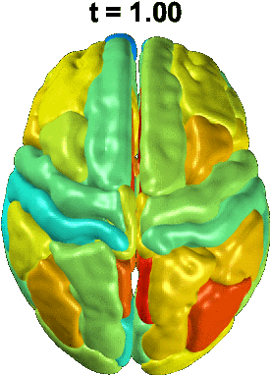
NEUROIMAGING AND ALZHEIMER’S DISEASE (AD)
PiB PET imaging
(Pittsburgh compound B)
(Positron-emission tomography)
$↑\text{PiB} \text{Distribution} \text{V}\text{olume} \text{R}\text{atio}⇒ ↑$Amyloid $⇒$ $↑$Risk of Dementia
Notes:
For instance, PiB PET imaging specifically measures the amount of amyloid, by measuring the distribution volume ratio, OR DVR, of Pittsburgh compound B a PET radiotracer that binds to beta amyloid plaque in the brain. And Amyloid accumulation during time is acknowledged to be a primary pathological event in AD such that high amount of amyloid in the brain is associated with high risk of dementia. When we look at this neuroimaging while time factor is involved, the PET imaging measures become longitudinal or sequential.

Slide 5
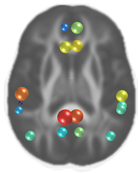
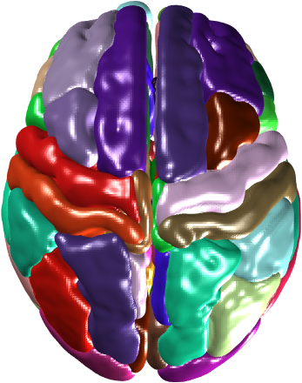

NEUROIMAGING AND ALZHEIMER’S DISEASE (AD)
PiB PET imaging
Regions of Interest
16 Regions (8 bilateral regions ) $⇒x∈ℝ^{16}$
Notes:
We sometimes focus on a subset of regions of interest in neuroimaging. In this figure, 16 gray matter regions known to be affected by AD are denoted using spheres for demonstration purpose.

Slide 6
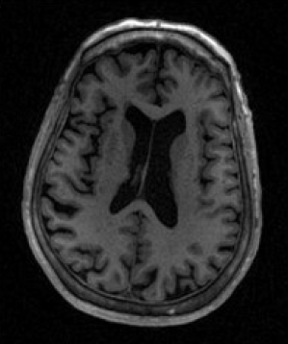
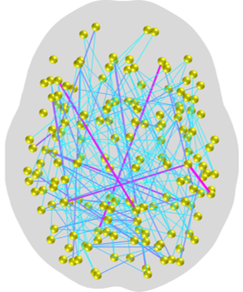
NEUROIMAGING AND ALZHEIMER’S DISEASE (AD)
T1 Weighted Magnetic Resonance Imaging
MRI
Structural Brain Connectivity
Notes:
Besides PET imaging, Magnetic resonance imaging is another important kind of neuroimaging. MRI measures spin–lattice relaxation during MRI scan which can inform the structural brain connectivity.

Slide 7
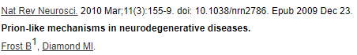
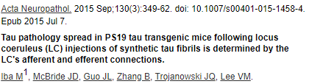
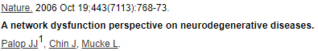
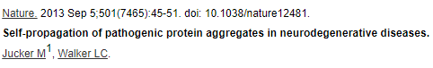
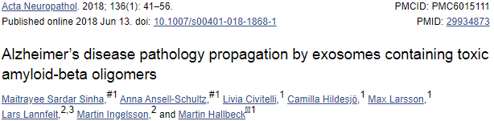
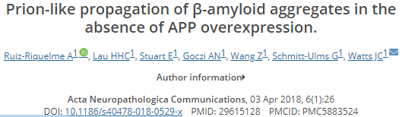
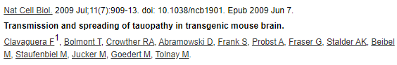
NEUROIMAGING AND ALZHEIMER’S DISEASE (AD)
Prion-like Transmission of AD Pathology along Structural Connectivity
Notes:
This also helps us understand the amyloid accumulation. As more and more literatures suggest that propagation of amyloid is a prion-like transmission which occurs along neural pathways as a function of the disease process.

Slide 8
NEUROIMAGING AND ALZHEIMER’S DISEASE (AD)
Pattern of spread in the preclinical stages of AD ?
Notes:
Though the two types of neuroimaging will help us along our way understanding AD, the pattern of spread in the preclinical stages of AD is still poorly understood. And Our work is motivated by this question.

Slide 9
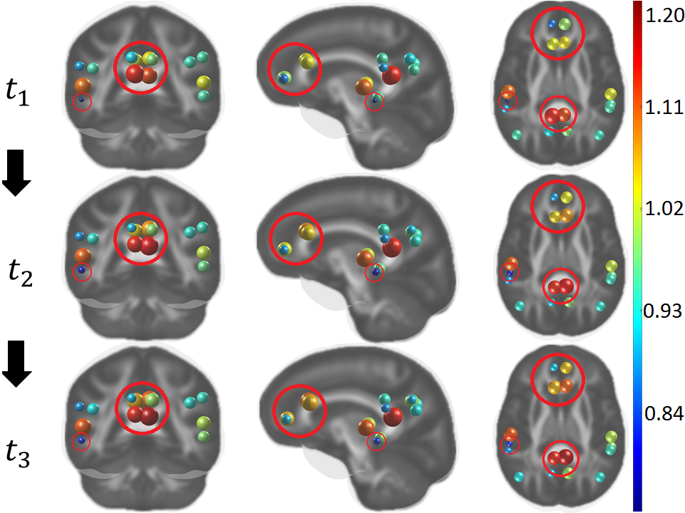
PROBLEM SETUP
Goal: Predict individual-level amyloid burden at future time points in preclinical Alzheimer’s disease (AD) using baseline image scans.
Importance: Predicting progression of AD pathology will facilitate identifying individuals most likely to benefit from anti-amyloid therapy.
Notes:
We try to predict individual-level amyloid burden at future time points in preclinical Alzheimer’s disease (AD) using baseline neuroimaging scans. This is very meaningful because predicting progression of the pathology will facilitate identifying individuals who are most likely to benefit from anti-amyloid therapy.

Slide 10
PROBLEM SETUP
Goal: Predict individual-level amyloid burden at future time points in preclinical Alzheimer’s disease (AD) using baseline image scans.
Challenge: Lack of methods for characterizing individual-level amyloid propagation patterns using both the individual amyloid scan as well as structural brain connectivity.
Region 1
Region 2
Notes:
The challenge we face is the lack of methods for characterizing individual-level amyloid propagation patterns, using both the individual amyloid scan as well as structural brain connectivity. As mentioned before, the latter factor is important because the structural brain connectivity informs the fiber pathways which guide amyloid progression from one region to the other in the brain.

Slide 11
PROBLEM SETUP
Goal: Predict individual-level amyloid burden at future time points in preclinical Alzheimer’s disease (AD) using baseline image scans.
Challenge: Lack of methods for characterizing individual-level amyloid propagation patterns using both the individual amyloid scan as well as structural brain connectivity.
Region 1
Region 2
Notes:
The challenge we face is the lack of methods for characterizing individual-level amyloid propagation patterns, using both the individual amyloid scan as well as structural brain connectivity. As mentioned before, the latter factor is important because the structural brain connectivity informs the fiber pathways which guide amyloid progression from one region to the other in the brain.

Slide 12
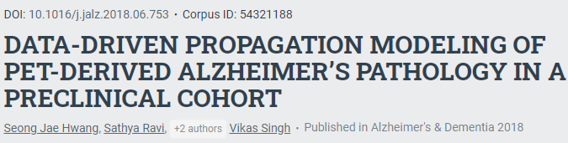
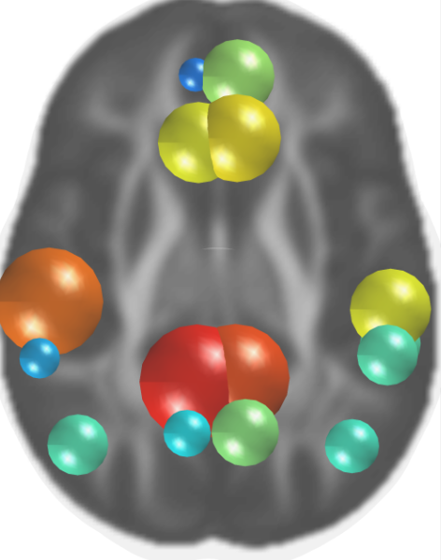
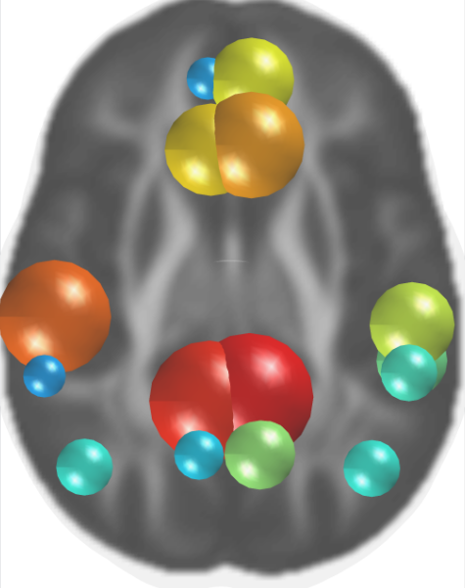
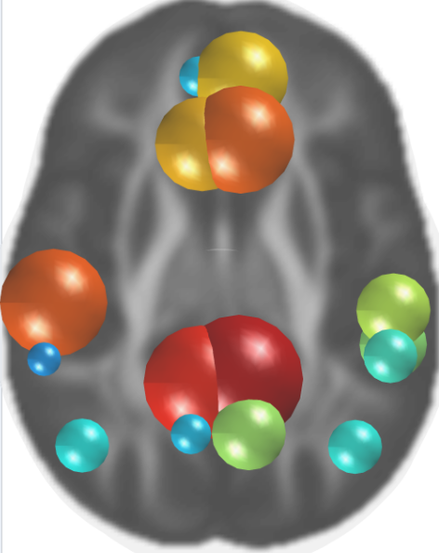
PREVIOUS WORK
PiB DVR
Group Level
Amyloid Burden Progresses Over Time
PiB DVR
Crafted group-level brain Connectivity
Predict individual-level amyloid burden
Subject 1
Subject 2
Subject 3
Notes:
In fact, in stead of individual-level prediction, a previous work tried to capture the group-level amyloid propagation, based on the full cohort’s amyloid scans. Its model infers a crafted group-level brain connectivity only from the PiB DVRs over time.
However, this crafted group-level connectivity cannot be used to characterize the individual level propagation because the derived propagation routes are for the full group and do not consider individual variations.

Slide 13
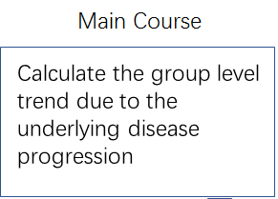
OBJECTIVES
Group Level
Individual Level
Amyloid Burden Progresses Over Time
Individual Variations
Make Individual level prediction using both the group level trend and the participant’s baseline imaging data.
Subject 1
Subject 3
Subject 2
Notes:
So, to characterize individual-level amyloid progression, we need to have a model, that knows how to map baseline PiB measurements to measurements over time, appropriately informed by the individual’s connectivity information. This prior knowledge will act as the main course of group-level progression trend due to the underlying disease pattern. And the model may use this knowledge to make individualized prediction.

Slide 14
1. NETWORK DIFFUSION MODEL
Notes:
To begin describing our model, we start with the idea of network diffusion model.

Slide 15

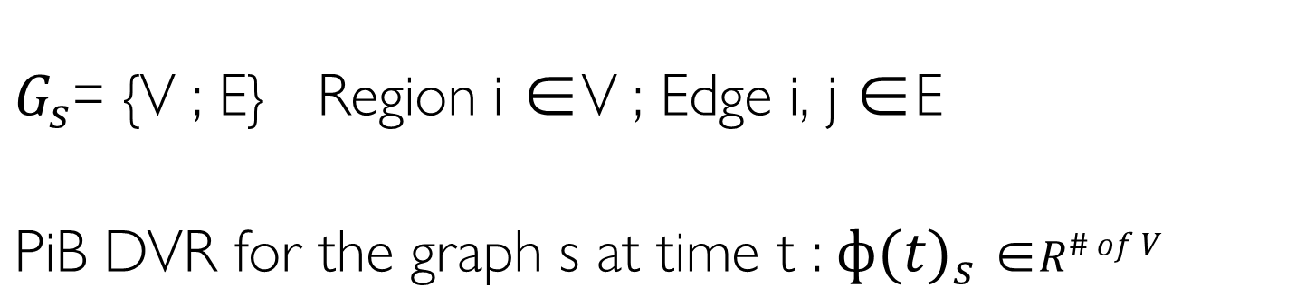
NETWORK DIFFUSION MODEL
$G_{s}$= {V ; E} Region i ∈V ; Edge i, j ∈E
PiB DVR for the graph s at time t :$ф(t)_{s}$ ∈$R^{\# of V}$
Diffusion Constant
$$\frac{dф(t)_{s}}{dt}=−k∙L_{s}∙ф(t)_{s}$$
Graph Laplacian
Notes:
Let’s imagine the brain as a connected graph s where brain regions are represented by vertices. And an edge means the existence of fiber path in between two regions.
Then, the amount of PiB DVR for the graph s at time t can be expressed by a vector Phi t s. When time passes, we can imagine the amyloid propagation as a heat diffusion process. And it can be written using a differential equation as shown below. The constant k denotes the diffusion speed and L is the graph Laplacian which stores the brain connectivity information in a matrix format.

Slide 16
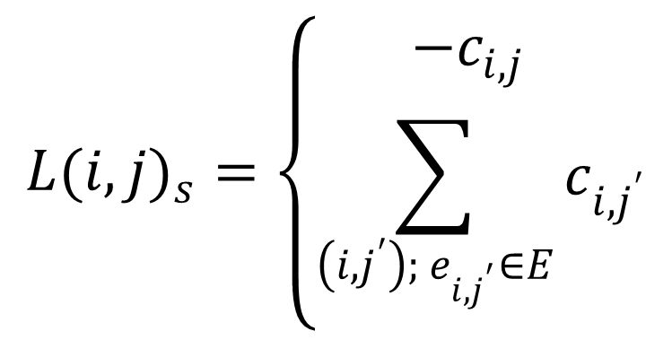
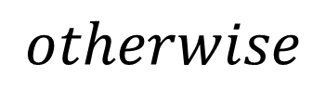
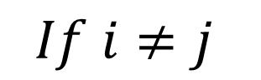

NETWORK DIFFUSION MODEL
$$\frac{dф(t)_{s}}{dt}=−k∙L_{s}∙ф(t)_{s}$$
$$L(i,j)_{s}=\left\{\begin{aligned}−c_{i,j} \\ \sum_{\left(i,j^{′}\right); e_{i,j^{′}}∈E}{c_{i,j^{′}}}\end{aligned}\right.$$
$$If i≠j$$
$$otherwise$$
$c_{i,j}$ is the connectivity strength between region i and j
Notes:
To be specific, each element in L can be expressed as shown. Where ci,j is the connectivity strength between region i and j. Noticeably, the graph Laplacian is symmetric.

Slide 17
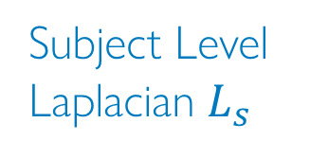
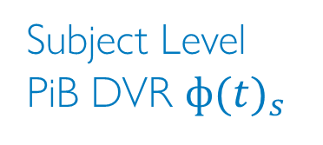
NETWORK DIFFUSION MODEL
Subject Level Laplacian $L_{s}$
Processed using the Computational Anatomy Toolbox and `Graynet’
16 × 16
T1 Weighted MRI
Structural Brain Connectivity
Subject Level PiB DVR $ф(t)_{s}$
16 × 1
PiB PET Imaging Detecting Amyloid Load
Notes:
The connectivity strength can be derived form T1 Weighted MRI using the Computational Anatomy Toolbox and `Graynet’ which are referenced in our paper. Since we will focus on the 16 gray matter regions known to be affected by AD during the amyloid propagation, the graph Laplacian for a subject s can be expressed as a 16 by 16 matrix.
Correspondingly, the Phi for that subject can be expressed as a 16 by 1 vector. With these information, we can start to formulate our model.

Slide 18
2. TRAINABLE MODEL

Slide 19
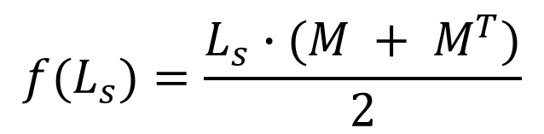


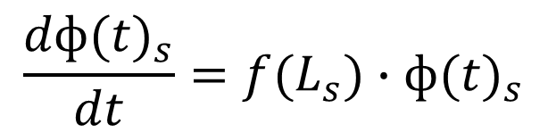
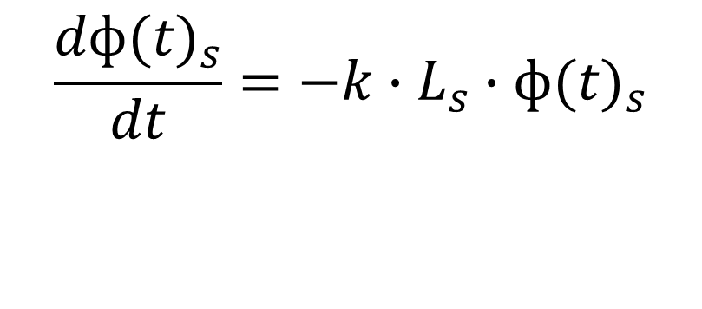
TRAINABLE MODEL
$$\frac{dф(t)_{s}}{dt}=−k∙L_{s}∙ф(t)_{s}$$
Trainable Group Parameter: 16 × 16
$$f(L_{s})=\frac{L_{s}∙(M + M^{T})}{2}$$
$$\frac{dф(t)_{s}}{dt}=f(L_{s})∙ф(t)_{s}$$
Element-wise Multiplication
Preserving Symmetricity of L
Initial Value Problem
Solvable via an Ordinary Differential Equation (ODE) Solver
Subject s’ PiB DVR at time$t_{k}$
$$ф(t_{k})_{s}=ф(t_{1})_{s}+\int_{t_{1}}^{t_{k}}{f(L_{s})∙ф\left(t\right)∙\text{dt}}$$
Notes:
To let the brain structural connectivity inform the model, we need to find a function mapping an individual L as input to an f(L) with the group trend applied.
we construct the function f as the following format where the M will act as a to-be-learned group parameter. It has the same size as the input Laplacian. The M will store information about the cohort propagation course and the function can add ‘individual variation’ to the ‘Main course’ by tuning M during the training process. In this format, predicting a subject’s PiB DVR at a future time point tk is formulated as an initial value problem. The problem is solvable via an ordinary differential equation solver which is referenced in our paper.

Slide 20
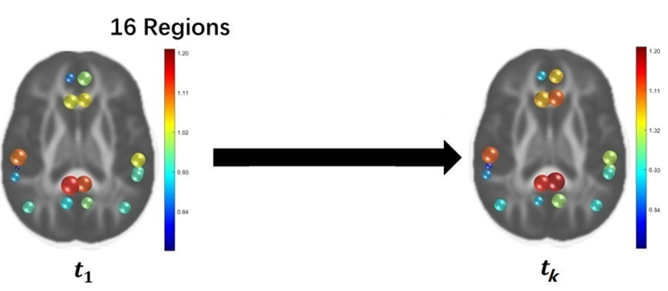
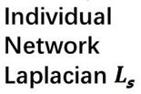
TRAINABLE MODEL
Notes:
Here is a summary of our model. To predict a subject’s PiB DVR at a future time point, the model takes the subject’s structural brain connectivity expressed as a Laplacian and a vector of the initial PiB DVR as inputs. A learned group parameter is applied to the Laplacian and an initial value problem is established via the network diffusion model. The predicted PiB DVR is then calculated by an ODE solver.

Slide 21
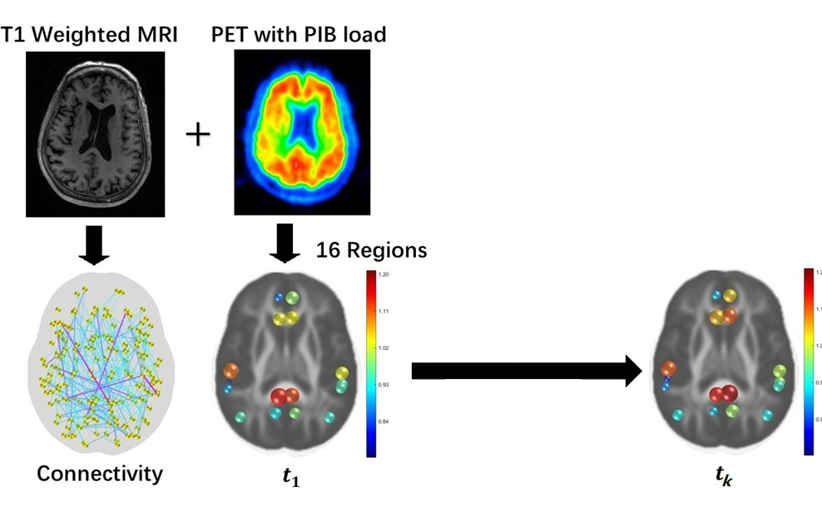
TRAINABLE MODEL
Notes:
Here is a summary of our model. To predict a subject’s PiB DVR at a future time point, the model takes the subject’s structural brain connectivity expressed as a Laplacian and a vector of the initial PiB DVR as inputs. A learned group parameter is applied to the Laplacian and an initial value problem is established via the network diffusion model. The predicted PiB DVR is then calculated by an ODE solver.

Slide 22
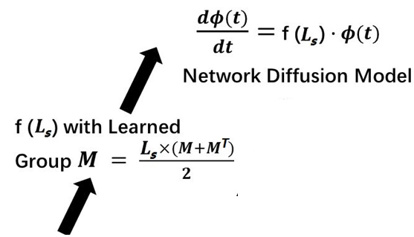
TRAINABLE MODEL
Notes:
Here is a summary of our model. To predict a subject’s PiB DVR at a future time point, the model takes the subject’s structural brain connectivity expressed as a Laplacian and a vector of the initial PiB DVR as inputs. A learned group parameter is applied to the Laplacian and an initial value problem is established via the network diffusion model. The predicted PiB DVR is then calculated by an ODE solver.

Slide 23

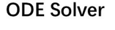
TRAINABLE MODEL
Notes:
Here is a summary of our model. To predict a subject’s PiB DVR at a future time point, the model takes the subject’s structural brain connectivity expressed as a Laplacian and a vector of the initial PiB DVR as inputs. A learned group parameter is applied to the Laplacian and an initial value problem is established via the network diffusion model. The predicted PiB DVR is then calculated by an ODE solver.

Slide 24
3. EXPERIMENTAL SETUP AND RESULTS
Notes:
With the established model, we run some experiments to evaluate it on real data set.

Slide 25
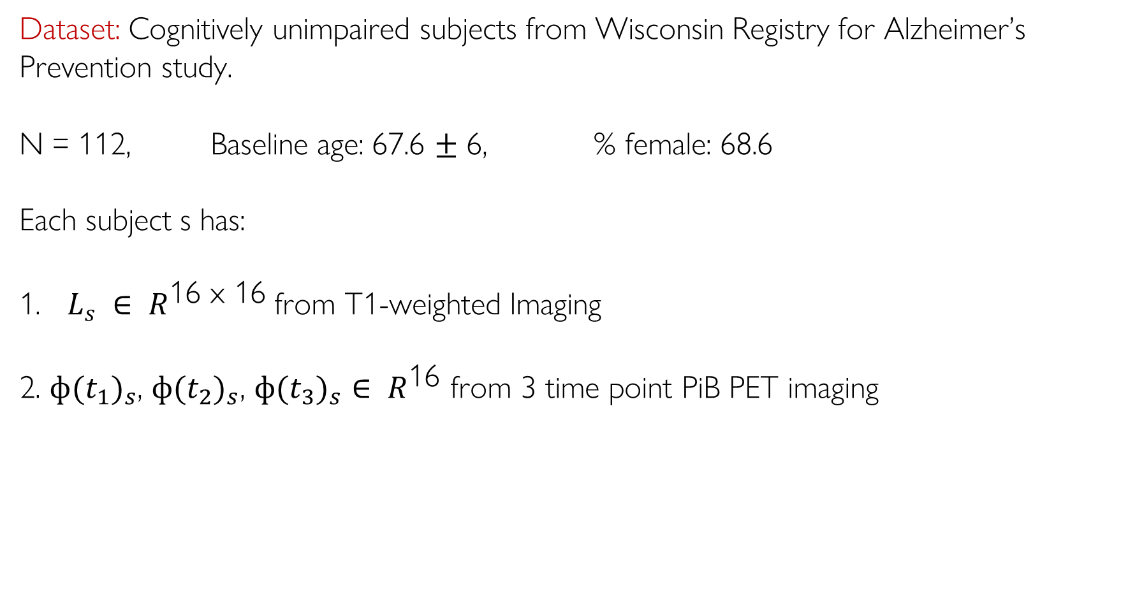
1. INVERTIBLE NEURAL NETWORK
EXPERIMENTAL SETUP
Dataset: Cognitively unimpaired subjects from Wisconsin Registry for Alzheimer’s Prevention study.
N = 112, Baseline age: 67.6 $±$ 6, % female: 68.6
Each subject s has:
$L_{s} ∈ R^{\text{16 }\text{x}\text{ 16}}$from T1-weighted Imaging
2. $ф(t_{1})_{s}$, $ф(t_{2})_{s}$, $ф(t_{3})_{s}∈ R^{\text{16}}$ from 3 time point PiB PET imaging
Notes:
The longitudinal dataset is from Wisconsin Registry for Alzheimer’s Prevention study. 112 cognitively unimpaired subjects with at least three time points of PiB-PET scans and baseline T1-weighted MRI were included.

Slide 26
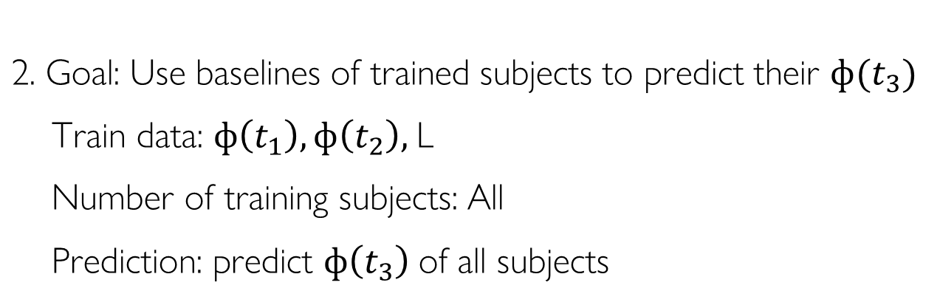
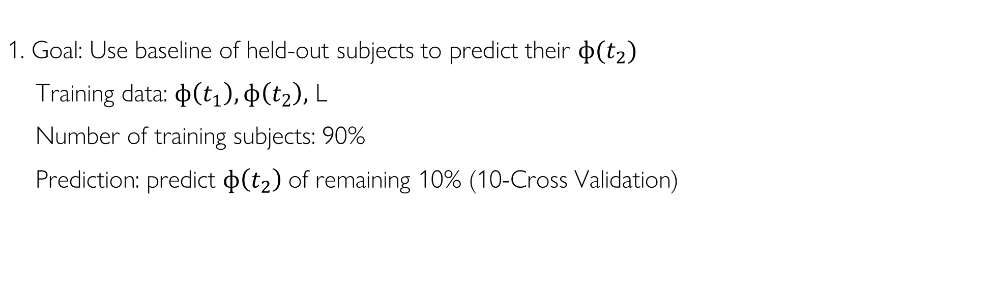
MODEL EVALUATION
Two settings with different dataset splits:
1. Goal: Use baseline of held-out subjects to predict their $ф(t_{2})$
Training data: $ф\left(t_{1}\right), ф\left(t_{2}\right),$ L
Number of training subjects: 90%
Prediction: predict $ф\left(t_{2}\right)$of remaining 10% (10-Cross Validation)
2. Goal: Use baselines of trained subjects to predict their $ф(t_{3})$
Train data: $ф\left(t_{1}\right), ф\left(t_{2}\right),$L
Number of training subjects: All
Prediction: predict $ф\left(t_{3}\right)$of all subjects
Notes:
We evaluate the model in two settings with different dataset splits. The training data in the first setting includes 90% of the subjects and the Model is trained using $ф(t_{1})$,$ф(t_{2})$ and L. We estimate the accuracy of estimated amyloid loads at $t_{2}$ given only the baseline $ф\left(t_{1}\right)$on the remaining 10% subjects. And we perform a10-fold cross-validation.
The training data in the second setting includes all of the subjects and the Model is trained using $ф(t_{1})$,$ф(t_{2})$ and L where scans at $t_{3}$ are held out. We estimate the accuracy of estimated amyloid loads at $t_{3}$ given only the baseline $ф\left(t_{1}\right)$ on all subjects.

Slide 27
COMPARISON WITH INFERENCE BASED ON LINEAR ESTIMATE
$\hat{ф^{′}} (t_{k})_{s}$ = $ф(t_{1})_{s}$ + $\frac{\sum_{s^{′}=1,s^{′}≠s}^{n}{(ф(t_{k})_{s^{′}}−ф(t_{1})_{s^{′}})}}{n−1}$
Baseline PiB DVR
Linear Estimate
Notes:
We compare our prediction phi prime with a simple prediction made by a naïve linear estimate method denoted using phi prime hat.

Slide 28
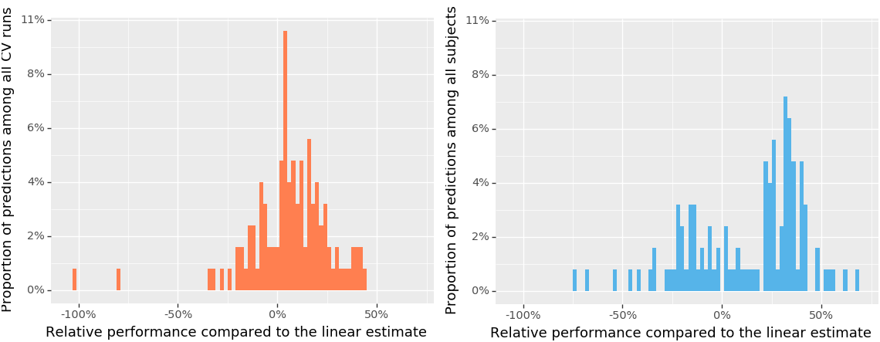
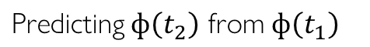
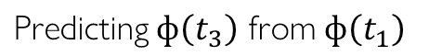
COMPARISON WITH INFERENCE BASED ON LINEAR ESTIMATE
$\hat{ф^{′}} (t_{k})_{s}$ = $ф(t_{1})_{s}$ + $\frac{\sum_{s^{′}=1,s^{′}≠s}^{n}{(ф(t_{k})_{s^{′}}−ф(t_{1})_{s^{′}})}}{n−1}$
70.5%
67.0%
Predicting $ф\left(t_{2}\right)$ from $ф\left(t_{1}\right)$
Predicting $ф\left(t_{3}\right)$ from $ф\left(t_{1}\right)$
Notes:
The figure below shows that our model yields more accurate predictions of PiB-PET measurements in 70.5% of t2 samples and 67.0% of t3 samples, compared with the linear estimate.

Slide 29
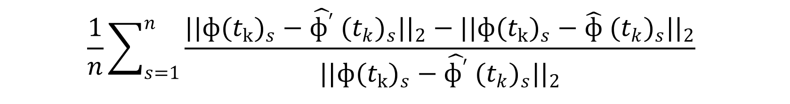
COMPARISON WITH INFERENCE BASED ON LINEAR ESTIMATE
$$\frac{1}{n}\sum_{s=1}^{n}{\frac{||ф(t_{k})_{s}−\hat{ф^{′}} (t_{k})_{s}{||}_{2}−||ф(t_{k})_{s}−\hat{ф} (t_{k})_{s}{||}_{2}}{||ф(t_{k})_{s}−\hat{ф^{′}} (t_{k})_{s}{||}_{2}}}$$
Average precision gain of 16.0%
Average precision gain of 30.1%
Notes:
We also calculated how good our predictions are when they outperform the linear estimates. The figure and numbers tell us that our model captures most of the propagation patterns and performs better at a further time point t3 when only the baseline scans of each subject is available

Slide 30
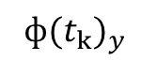
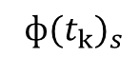
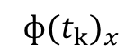
HOW CLOSE IS OUR PREDICTION TO THE REAL DATA?
$ф(t_{k})_{s}$
Comparison with the Distance To Other Subject’s Data
$ф(t_{k})_{x}$
$ф(t_{k})_{y}$
Notes:
Another question we ask when performing evaluation is: how close is our prediction to the real data? We ask this question in two analogous scenarios:
First,
Among all test subjects, the L2-norm is calculated between our prediction$\hat{ф} (t_{k})_{s}$ for subject s and real DVR vector $ф(t_{k})$ for each test subject. The most ideal case is that our prediction is the closest towards the subject s’ $ф(t_{k})_{s}$ other than other test subject’s $ф(t_{k})$, since we are performing the prediction for that particular subject s, not for other subjects. So, the closer our prediction towards the real DVR data we are targeting, the better the model is.

Slide 31

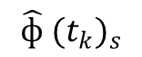
HOW CLOSE IS OUR PREDICTION TO THE REAL DATA?
$$\hat{ф} (t_{k})_{s}$$
$ф(t_{k})_{s}$
Comparison with the Distance To Other Subject’s Data
$ф(t_{k})_{x}$
$ф(t_{k})_{y}$
Notes:
Another question we ask when performing evaluation is: how close is our prediction to the real data? We ask this question in two analogous scenarios:
First,
Among all test subjects, the L2-norm is calculated between our prediction$\hat{ф} (t_{k})_{s}$ for subject s and real DVR vector $ф(t_{k})$ for each test subject. The most ideal case is that our prediction is the closest towards the subject s’ $ф(t_{k})_{s}$ other than other test subject’s $ф(t_{k})$, since we are performing the prediction for that particular subject s, not for other subjects. So, the closer our prediction towards the real DVR data we are targeting, the better the model is.

Slide 32

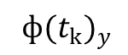
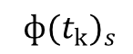
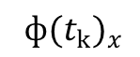
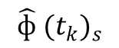
HOW CLOSE IS OUR PREDICTION TO THE REAL DATA?
$ф(t_{k})_{s}$
$$\hat{ф} (t_{k})_{s}$$
Comparison with the Distance To Other Subject’s Data
$ф(t_{k})_{x}$
$ф(t_{k})_{y}$
Notes:
Another question we ask when performing evaluation is: how close is our prediction to the real data? We ask this question in two analogous scenarios:
First,
Among all test subjects, the L2-norm is calculated between our prediction$\hat{ф} (t_{k})_{s}$ for subject s and real DVR vector $ф(t_{k})$ for each test subject. The most ideal case is that our prediction is the closest towards the subject s’ $ф(t_{k})_{s}$ other than other test subject’s $ф(t_{k})$, since we are performing the prediction for that particular subject s, not for other subjects. So, the closer our prediction towards the real DVR data we are targeting, the better the model is.

Slide 33




HOW CLOSE IS OUR PREDICTION TO THE REAL DATA?
$ф(t_{k})_{s}$
$$Randomly Generated data$$
$$\hat{ф} (t_{k})_{s}$$
$$Randomly Generated data$$
Comparison with the Randomly Generated Data
Notes:
The second scenario for the ‘how close question’ is: to compare our prediction with 99 randomly generated phi hat data that come from a certain distribution which artificially “simulate” test subjects. Similarly, the less artificial test subjects in between our prediction towards the real DVR data of subject s, the better the model is.

Slide 34


HOW CLOSE IS OUR PREDICTION TO THE REAL DATA?
$ф(t_{k})_{s}$
$$\hat{ф} (t_{k})_{s}$$
$$Randomly Generated data$$
$$Randomly Generated data$$
Comparison with the Randomly Generated Data
Notes:
The second scenario for the ‘how close question’ is: to compare our prediction with 99 randomly generated phi hat data that come from a certain distribution which artificially “simulate” test subjects. Similarly, the less artificial test subjects in between our prediction towards the real DVR data of subject s, the better the model is.

Slide 35




HOW CLOSE IS OUR PREDICTION TO THE REAL DATA?
(a)
(b)
95% of our predictions for a subject is the closest
Predicting $ф\left(t_{2}\right)$ from $ф\left(t_{1}\right)$
(c)
(d)
93% of our predictions for a subject is the closest
Predicting $ф\left(t_{3}\right)$ from $ф\left(t_{1}\right)$
Notes:
Let’s look at the result. In Figure (a) and (c), we use the cohort distribution and the individual’s measurement distribution to artificially “simulate” test subjects for predicting phi t2 and phi t3 in our second scenario. The detailed method for generating random data are described in our paper. In both cases, we find that the model performs well. 95% and 93% of our predictions for a subject is the closest towards the real DVR data for predicting phi t2 and phi t3 respectively. Similarly, Figure (b) and (d) show reasonably good results for measuring the “how close” question regards to our first scenario when we do comparison with the distance to other Subject’s Data.

Slide 36
HOW CLOSE IS OUR PREDICTION TO THE REAL DATA?
(a)
(b)
95% of our predictions for a subject is the closest
Predicting $ф\left(t_{2}\right)$ from $ф\left(t_{1}\right)$
(c)
(d)
93% of our predictions for a subject is the closest
Predicting $ф\left(t_{3}\right)$ from $ф\left(t_{1}\right)$
Notes:
Let’s look at the result. In Figure (a) and (c), we use the cohort distribution and the individual’s measurement distribution to artificially “simulate” test subjects for predicting phi t2 and phi t3 in our second scenario. The detailed method for generating random data are described in our paper. In both cases, we find that the model performs well. 95% and 93% of our predictions for a subject is the closest towards the real DVR data for predicting phi t2 and phi t3 respectively. Similarly, Figure (b) and (d) show reasonably good results for measuring the “how close” question regards to our first scenario when we do comparison with the distance to other Subject’s Data.

Slide 37
GROUP DIFFERENCE ANALYSIS: APOE e4 + vs. APOE e4 -
APOE e4:
The APOE gene provides instructions for making a protein called apolipoprotein E & one allele, APOE e4 is associated with Alzheimer’s disease since its a risk factor for beta protein deposition.
Notes:
The last question we want to ask for evaluation is: can our model find the different amyloid progression pattern between two distinct groups?
So, we choose to do a group difference analysis via statistical test between the apoe e4+ and the apoe e4- group where APOE e4 is the risk genotype for Alzheimer's disease.

Slide 38

GROUP DIFFERENCE ANALYSIS: APOE e4 + vs. APOE e4 -
APOE e4:
The APOE gene provides instructions for making a protein called apolipoprotein E & one allele, APOE e4 is associated with Alzheimer’s disease since its a risk factor for beta protein deposition.
Statistical Test
Split the dataset and train two models： APOE e4 + (n = 45) and APOE e4 - (n = 67).
$l_{2}$ norm between $M_{1}$ and $M_{2}$ (the learned group parameters) from two models is computed ---the statistical summary for the correct group.
Null Hypothesis $H_{0}$ : There is no group level difference between the parameters within these two groups.
Notes:
To setup, we split the dataset with an APOE e4 positive group of 45 subjects and an APOE e4 negative group of 67 subjects. We then train two models based on the split. we computed the $l_{2}$ norm between $M_{1}$ and $M_{2}$ from the two models as the statistical summary for the correct group.
Our Null Hypothesis $is$ that There is no group level difference between the parameters within these two groups.

Slide 39

GROUP DIFFERENCE ANALYSIS: APOE e4 + vs. APOE e4 -
Permutation Testing:
1. split data randomly with same group sizes (45 and 67)
2. Calculate the difference between $M_{s}$ from the two models
3. Repeat for 10K draws
4. Derive null distribution of summary statistic
5. Compute p-value
Notes:
We then do a permutation Testing following the procedure below for 10K draws to derive null distribution of summary statistic and compute the p-value.
As a result, the p-value is way smaller than the significance threshold. This implies that our model captures the difference of amyloid progression pattern in the two groups. Which further implies the capture of amyloid propagation dynamic in the pre-clinical stage of AD.

Slide 40

GROUP DIFFERENCE ANALYSIS: APOE e4 + vs. APOE e4 -
Permutation Testing:
1. split data randomly with same group sizes (45 and 67)
2. Calculate the difference between $M_{s}$ from the two models
3. Repeat for 10K draws
4. Derive null distribution of summary statistic
5. Compute p-value
Result: The p-value is 0.00467 which is smaller than the significance threshold = 0.05.
Our model captures the difference of amyloid progression pattern in APOE e4 + and APOE e4 - groups
Notes:
We then do a permutation Testing following the procedure below for 10K draws to derive null distribution of summary statistic and compute the p-value.
As a result, the p-value is way smaller than the significance threshold. This implies that our model captures the difference of amyloid progression pattern in the two groups. Which further implies the capture of amyloid propagation dynamic in the pre-clinical stage of AD.

Slide 41
CONCLUSION & FUTURE WORK
Our model successfully predicts individual-level amyloid burden at future time points in preclinical Alzheimer’s disease (AD) using both the individual amyloid scan as well as structural brain connectivity.
Notes:
Lastly, I want to draw a conclusion that :Our model successfully predict individual-level amyloid burden at future time points in preclinical Alzheimer’s disease (AD) using both the individual amyloid scan as well as structural brain connectivity.
For the future work:
Recent studies have shown that the early amyloid accumulation patterns may be a strong indicator of AD-related cognitive decline.
Our model could serve as a way to estimate the early amyloid accumulation trajectory in
the unobserved past (e.g., t < 1) by “reversing” the direction of the prediction process (sign change of f(L)) and estimating the start time of amyloid accumulation.

Slide 42
CONCLUSION & FUTURE WORK
Our model successfully predicts individual-level amyloid burden at future time points in preclinical Alzheimer’s disease (AD) using both the individual amyloid scan as well as structural brain connectivity.
Recent studies have shown that the early amyloid accumulation patterns may be a strong
indicator of AD-related cognitive decline.
Our model could serve as a way to estimate the early amyloid accumulation trajectory in
the unobserved past (e.g., t < 1) by “reversing” the direction of the prediction process (sign change of f(L)) and estimating the start time of amyloid accumulation.
Notes:
Lastly, I want to draw a conclusion that :Our model successfully predict individual-level amyloid burden at future time points in preclinical Alzheimer’s disease (AD) using both the individual amyloid scan as well as structural brain connectivity.
For the future work:
Recent studies have shown that the early amyloid accumulation patterns may be a strong indicator of AD-related cognitive decline.
Our model could serve as a way to estimate the early amyloid accumulation trajectory in
the unobserved past (e.g., t < 1) by “reversing” the direction of the prediction process (sign change of f(L)) and estimating the start time of amyloid accumulation.

Slide 43



COLLABORATORS AND ACKNOWLEDGMENTS
Wei Hao Nicholas M. Vogt Zihang Meng Seong Jae Hwang Rebecca L. Koscik Sterling C. Johnson Barbara B. Bendlin Vikas Singh
Acknowledgments. This project was supported in part by RF1 AG059312, R01 AG037639, R01 AG027161, R01 AG021155, P50 AG033514, UW CPCP (U54AI117924) and NSF CAREER award RI 1252725.
Github: https://github.com/vsingh-group/ISBI
Notes:
Thank you very much for listening.

